Slide 1
ENEL 419
8-9 Estimation Theory and Application
(Reading Exercises: Montgomery and Runger – Chapter 7)
(Reading Exercises: Yates and Goodman – Chapter 10)

Slide 2
Estimation
Definition:
Estimation is a procedure used to obtain an estimate of desired statistics or parameters from a set of random data samples drawn from a controlled experiment or from a population.

Slide 3
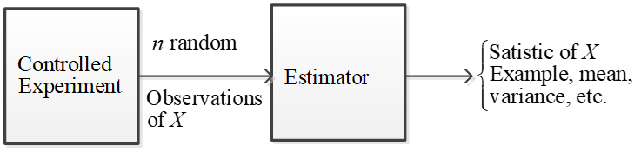
Controlled Experiment

Slide 4
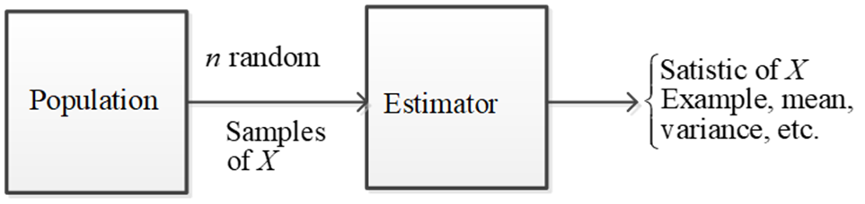
Non-controlled Experiment
A controlled experiment involves generating random data with an embedded, desired parameter (or parameters). The estimator is then used to extract the desired parameters.

Slide 5
Learning Outcomes
Be able to
Determine if an estimator is biased or unbiased.
Determine if an estimator is minimum variance.
Describe the difference between point estimation and interval estimation
Establish a confidence intervals for the true population mean
Apply the methods learned in the section to new problems.

Slide 6
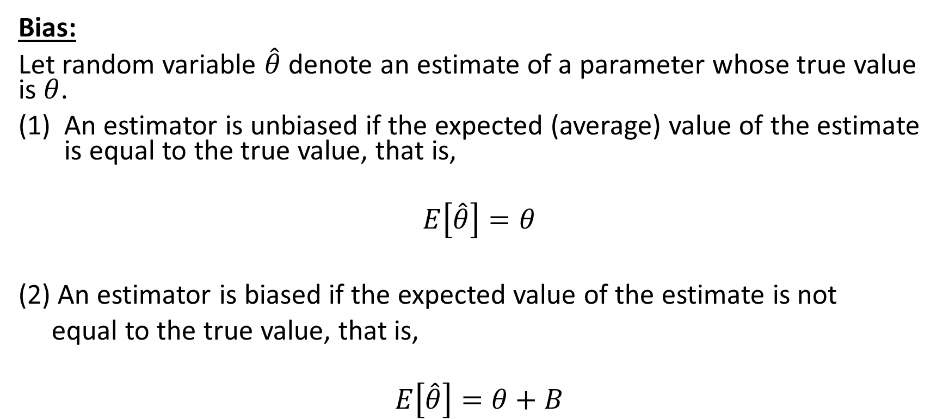
Properties of Good Estimators
Bias:
Let random variable $\hat{θ}$ denote an estimate of a parameter whose true value is $θ$.
An estimator is unbiased if the expected (average) value of the estimate is equal to the true value, that is,
$$E\left[\hat{θ}\right]=θ$$
(2) An estimator is biased if the expected value of the estimate is not
equal to the true value, that is,
$$E\left[\hat{θ}\right]=θ+B$$

Slide 7
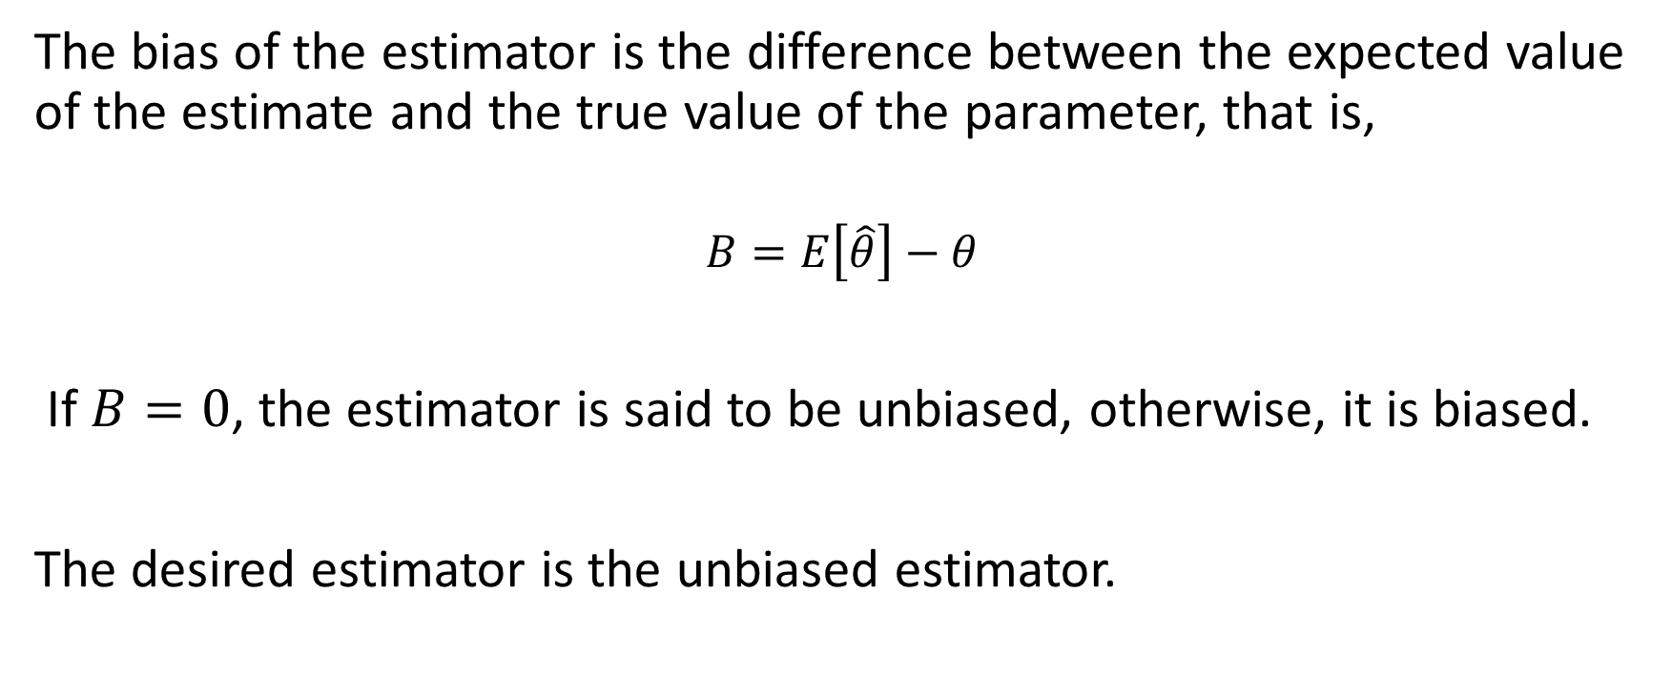
Properties of Good Estimators
The bias of the estimator is the difference between the expected value of the estimate and the true value of the parameter, that is,
$$B=E\left[\hat{θ}\right]−θ$$
If $B=0$, the estimator is said to be unbiased, otherwise, it is biased.
The desired estimator is the unbiased estimator.

Slide 8
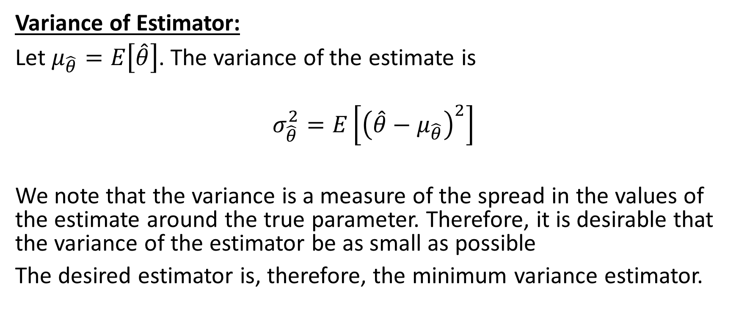
Properties of Good Estimators
Variance of Estimator:
Let $μ_{\hat{θ}}=E\left[\hat{θ}\right]$. The variance of the estimate is
$$σ_{\hat{θ}}^{2}=E\left[{\left(\hat{θ}−μ_{\hat{θ}}\right)}^{2}\right]$$
We note that the variance is a measure of the spread in the values of the estimate around the true parameter. Therefore, it is desirable that the variance of the estimator be as small as possible
The desired estimator is, therefore, the minimum variance estimator.

Slide 9
Properties of Good Estimators
Consistent Estimator:
A consistent estimator is one whose variance and bias tend to zero as the number of samples, used for the estimate, approach infinity.

Slide 10
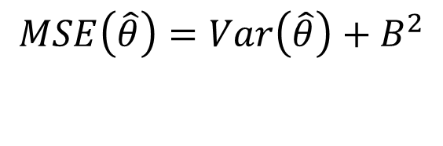
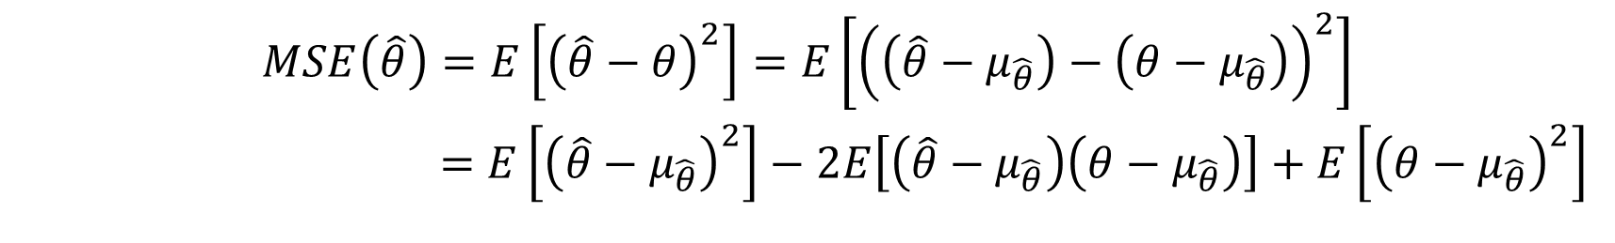
Properties of Good Estimators
Mean Square Error:
Conclusion:
For overall accuracy, the desired estimator is a minimum variance, unbiased estimator (MVUE).
$$\begin{matrix}MSE\left(\hat{θ}\right)=E\left[{\left(\hat{θ}−θ\right)}^{2}\right]=E\left[{\left(\left(\hat{θ}−μ_{\hat{θ}}\right)−\left(θ−μ_{\hat{θ}}\right)\right)}^{2}\right] \\ =E\left[{\left(\hat{θ}−μ_{\hat{θ}}\right)}^{2}\right]−2E\left[\left(\hat{θ}−μ_{\hat{θ}}\right)\left(θ−μ_{\hat{θ}}\right)\right]+E\left[{\left(θ−μ_{\hat{θ}}\right)}^{2}\right] \\ \end{matrix}$$
$$\begin{matrix}MSE\left(\hat{θ}\right)=Var\left(\hat{θ}\right)+B^{2} \\ \\ \end{matrix}$$

Slide 11
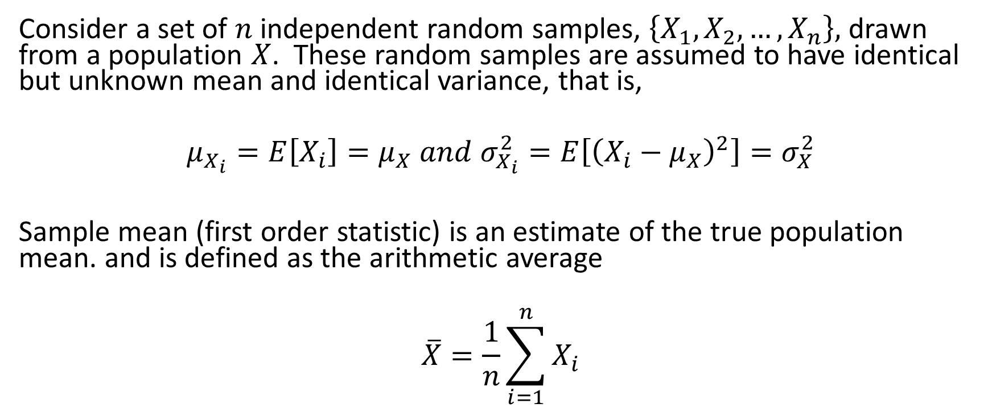
Mean Estimator: Sample Mean
Consider a set of $n$ independent random samples, $\left\{X_{1}, X_{2}, …, X_{n}\right\},$ drawn from a population $X$. These random samples are assumed to have identical but unknown mean and identical variance, that is,
$$μ_{X_{i}}=E\left[X_{i}\right]=μ_{X} and{ σ}_{X_{i}}^{2}=E\left[{\left(X_{i}−μ_{X}\right)}^{2}\right]=σ_{X}^{2}$$
Sample mean (first order statistic) is an estimate of the true population mean. and is defined as the arithmetic average
$$\overline{X}=\frac{1}{n}\sum_{i=1}^{n}{X_{i}}$$

Slide 12

Mean of Sample Mean
The sample mean is an unbiased estimator of the true mean.
$$\overline{X}=\frac{1}{n}\sum_{i=1}^{n}{X_{i}}$$
$$μ_{\overline{X}}=E\left[\overline{X}\right]=\frac{1}{n}\sum_{i=1}^{n}{E\left[X_{i}\right]}=μ_{X}$$

Slide 13
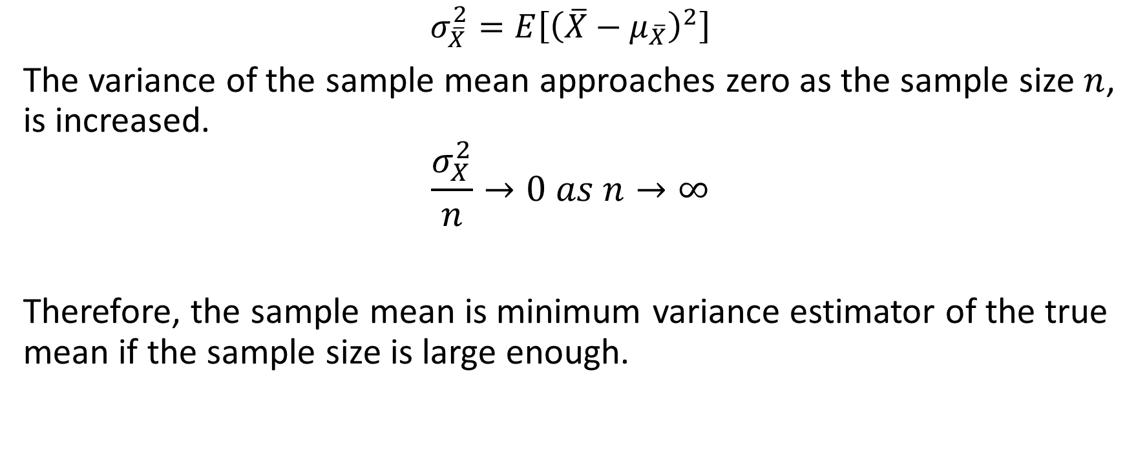
Variance of Sample Mean
$$σ_{\overline{X}}^{2}=E\left[{\left(\overline{X}−μ_{\overline{X}}\right)}^{2}\right]$$
The variance of the sample mean approaches zero as the sample size $n$, is increased.
$$\frac{σ_{X}^{2}}{n}→0 as n→∞$$
Therefore, the sample mean is minimum variance estimator of the true mean if the sample size is large enough.

Slide 14
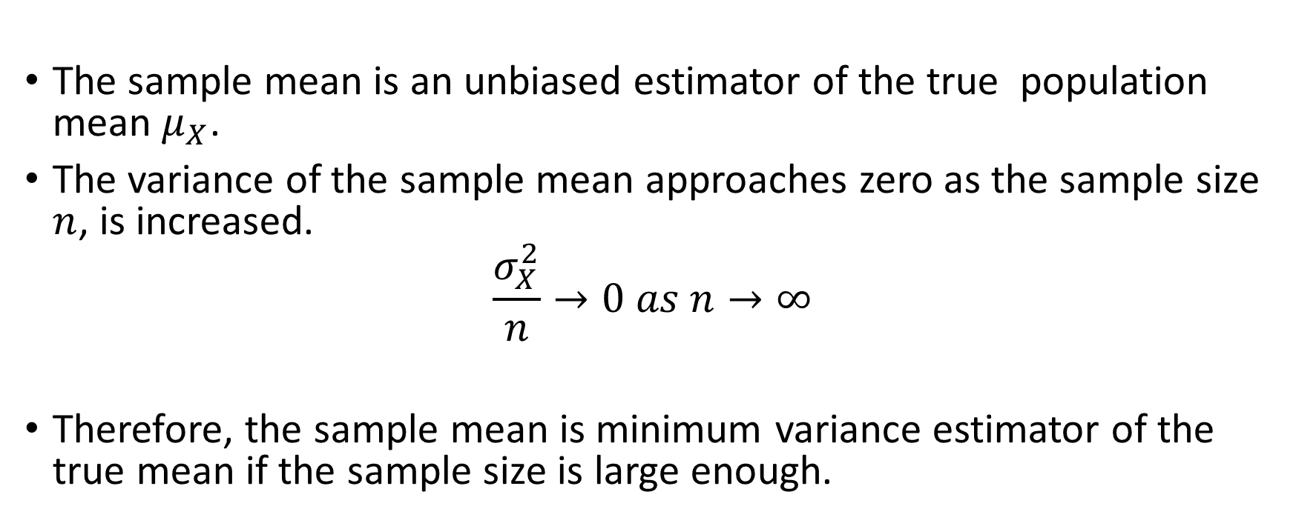
Conclusions
The sample mean is an unbiased estimator of the true population mean $μ_{X}$.
The variance of the sample mean approaches zero as the sample size $n$, is increased.
$$\frac{σ_{X}^{2}}{n}→0 as n→∞$$
Therefore, the sample mean is minimum variance estimator of the true mean if the sample size is large enough.

Slide 15
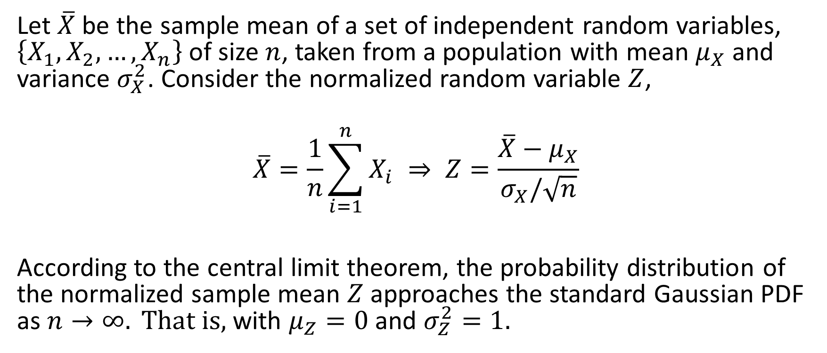
Central Limit Theorem Applied to the Sample Mean
Let $\overline{X}$ be the sample mean of a set of independent random variables, $\left\{X_{1}, X_{2}, …, X_{n}\right\}$ of size $n$, taken from a population with mean $μ_{X}$ and variance $σ_{X}^{2}$. Consider the normalized random variable $Z$,
$$\overline{X}=\frac{1}{n}\sum_{i=1}^{n}{X_{i}} ⇒ Z=\frac{\overline{X}−μ_{X}}{σ_{X}/\sqrt{n}}$$
According to the central limit theorem, the probability distribution of the normalized sample mean $Z$approaches the standard Gaussian PDF as $n→∞. That is,$ with $μ_{Z}=0$ and $σ_{Z}^{2}=1.$

Slide 16
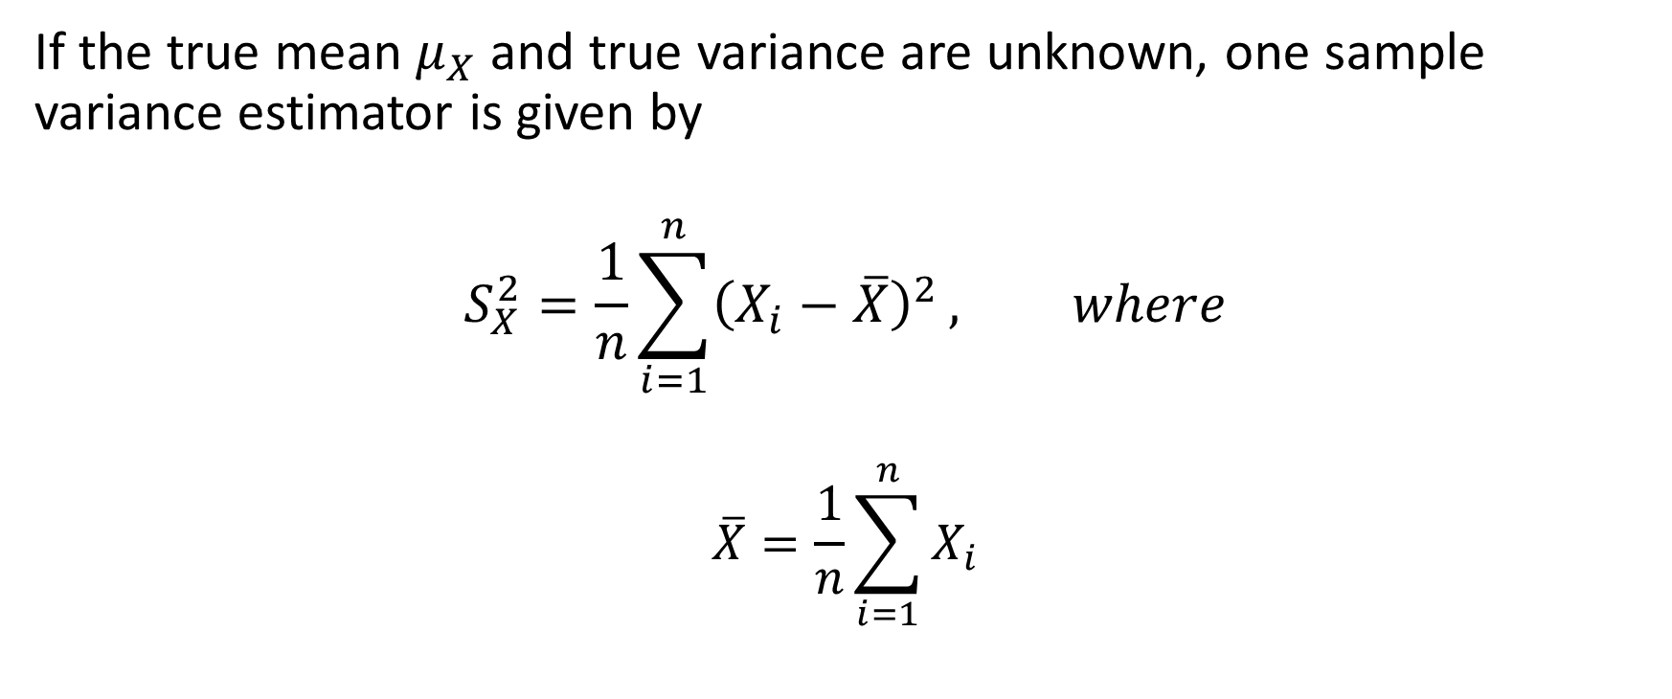
Sample Variance
If the true mean $μ_{X}$ and true variance are unknown, one sample variance estimator is given by
$$S_{X}^{2}=\frac{1}{n}\sum_{i=1}^{n}{{\left(X_{i}−\overline{X}\right)}^{2}}, where$$
$$\overline{X}=\frac{1}{n}\sum_{i=1}^{n}{X_{i}}$$

Slide 17
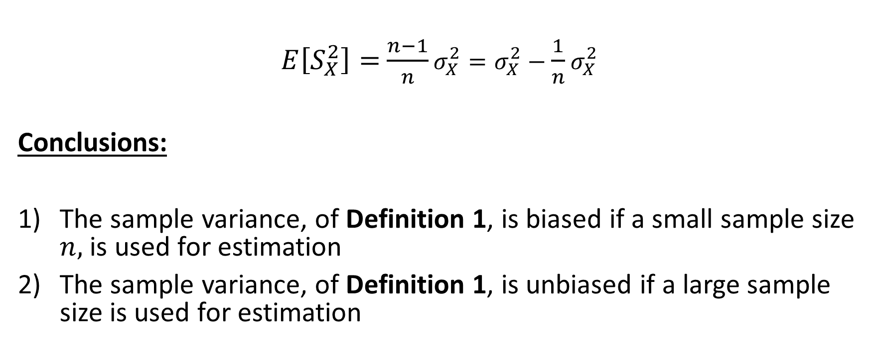
Sample Variance as Estimate of the True Variance
$E\left[S_{X}^{2}\right]=$ $\frac{n−1}{n}σ_{X}^{2}=σ_{X}^{2}−\frac{1}{n}σ_{X}^{2}$
Conclusions:
The sample variance, of Definition 1, is biased if a small sample size $n,$ is used for estimation
The sample variance, of Definition 1, is unbiased if a large sample size is used for estimation

Slide 18
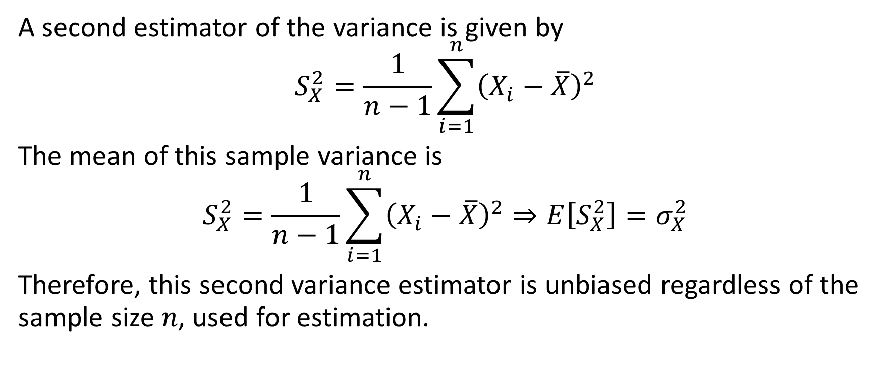
Sample Variance
A second estimator of the variance is given by
$$S_{X}^{2}=\frac{1}{n−1}\sum_{i=1}^{n}{{\left(X_{i}−\overline{X}\right)}^{2}}$$
The mean of this sample variance is
$$S_{X}^{2}=\frac{1}{n−1}\sum_{i=1}^{n}{{\left(X_{i}−\overline{X}\right)}^{2}⇒E\left[S_{X}^{2}\right]=σ_{X}^{2}}$$
Therefore, this second variance estimator is unbiased regardless of the sample size 𝑛, used for estimation.

Slide 19
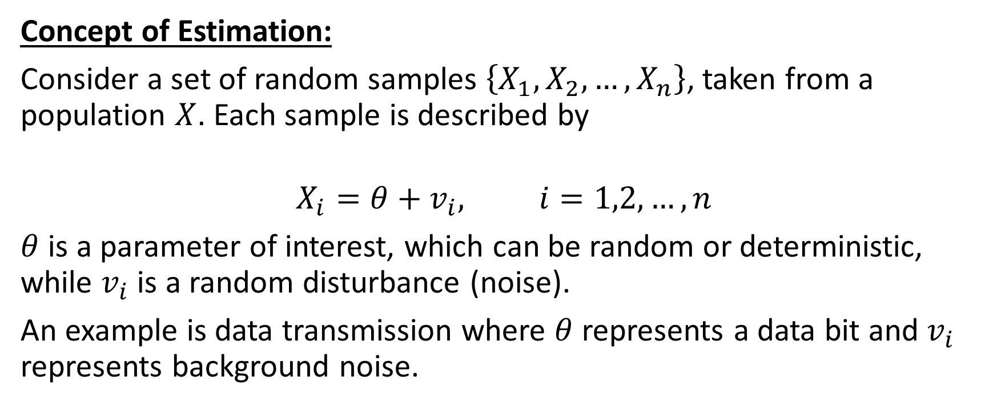
Methods for Obtaining Estimators
Concept of Estimation:
Consider a set of random samples $\left\{X_{1}, X_{2}, …, X_{n}\right\}$, taken from a population $X$. Each sample is described by
$$X_{i}=θ+v_{i}, i=1,2, …, n$$
$θ$ is a parameter of interest, which can be random or deterministic, while $v_{i}$ is a random disturbance (noise).
An example is data transmission where $θ$ represents a data bit and $v_{i}$ represents background noise.

Slide 20
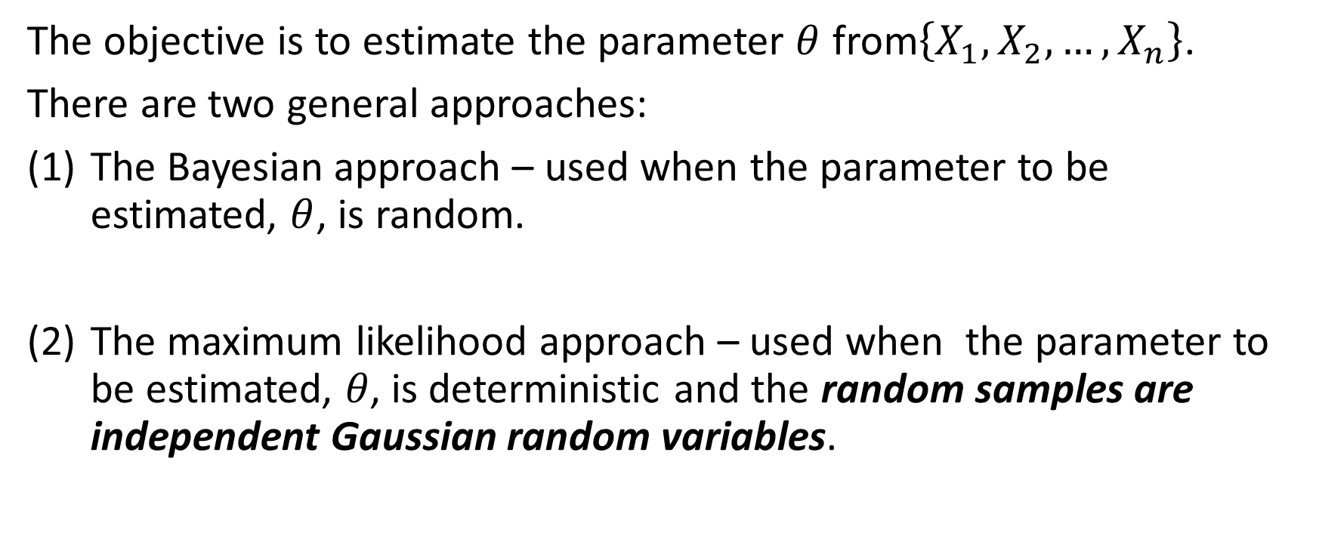
Parameter Estimation Approaches
The objective is to estimate the parameter $θ$ from$\left\{X_{1}, X_{2}, …, X_{n}\right\}$.
There are two general approaches:
The Bayesian approach – used when the parameter to be estimated, $θ$, is random.
The maximum likelihood approach – used when the parameter to be estimated, 𝜃, is deterministic and the random samples are independent Gaussian random variables.

Slide 21
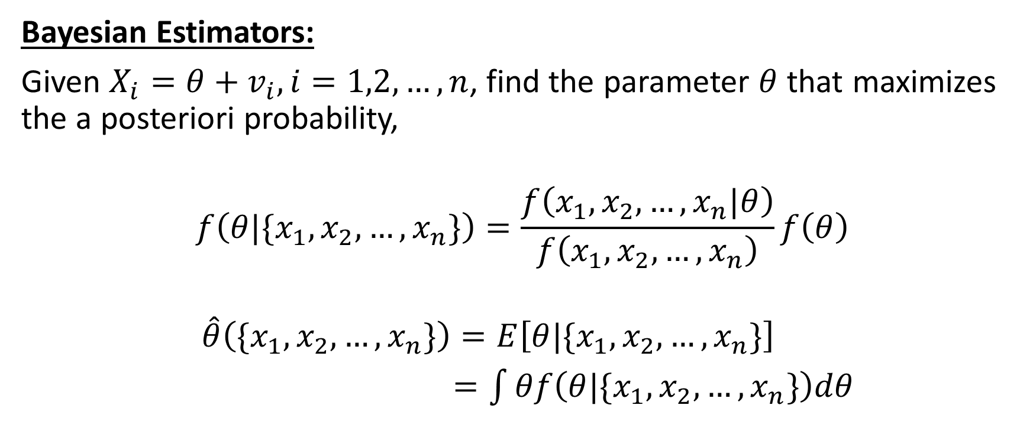
Methods for Obtaining Estimators
Bayesian Estimators:
Given $X_{i}=θ+v_{i}, i=1,2, …, n$, find the parameter $θ$ that maximizes the a posteriori probability,
$$f\left(θ|\{x_{1}, x_{2}, …, x_{n}\}\right)=\frac{f\left(x_{1}, x_{2}, …, x_{n}|θ\right)}{f\left(x_{1}, x_{2}, …, x_{n}\right)}f\left(θ\right)$$
$$\hat{θ}\left(\{x_{1}, x_{2}, …, x_{n}\}\right)=E\left[θ|\{x_{1}, x_{2}, …, x_{n}\}\right]$$
$=\int{θf\left(θ|\{x_{1}, x_{2}, …, x_{n}\}\right)dθ}$

Slide 22
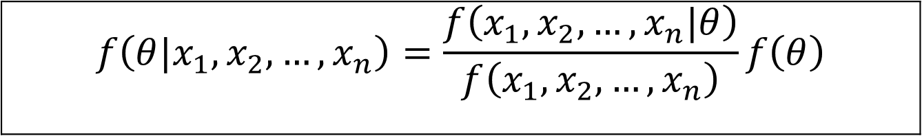
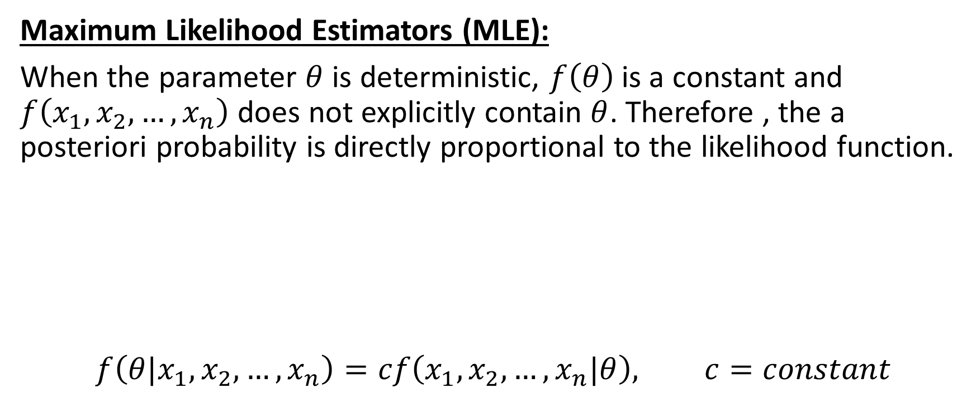
Methods for Obtaining Estimators
Maximum Likelihood Estimators (MLE):
When the parameter $θ$ is deterministic, $f\left(θ\right)$is a constant and $f\left(x_{1}, x_{2}, …, x_{n}\right)$ does not explicitly contain $θ$. Therefore , the a posteriori probability is directly proportional to the likelihood function.
$$f\left(θ|x_{1}, x_{2}, …, x_{n}\right)=cf\left(x_{1}, x_{2}, …, x_{n}|θ\right), c=constant$$
$$f\left(θ|x_{1}, x_{2}, …, x_{n}\right)=\frac{f\left(x_{1}, x_{2}, …, x_{n}|θ\right)}{f\left(x_{1}, x_{2}, …, x_{n}\right)}f\left(θ\right)$$

Slide 23
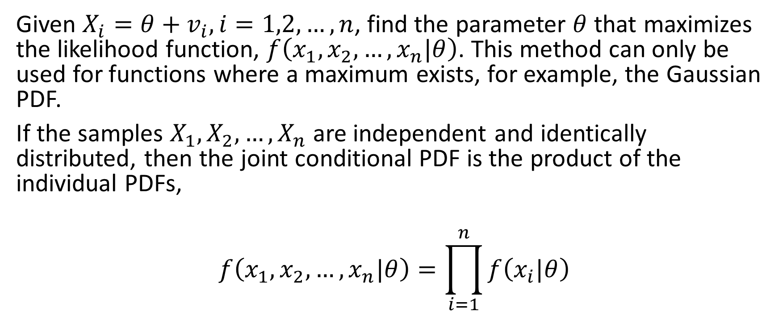
Maximum Likelihood Estimators
Given $X_{i}=θ+v_{i}, i=1,2, …, n$, find the parameter $θ$ that maximizes the likelihood function, $f\left(x_{1}, x_{2}, …, x_{n}|θ\right)$. This method can only be used for functions where a maximum exists, for example, the Gaussian PDF.
If the samples $X_{1}, X_{2}, …, X_{n}$ are independent and identically distributed, then the joint conditional PDF is the product of the individual PDFs,
$$f\left(x_{1}, x_{2}, …, x_{n}|θ\right)=\prod_{i=1}^{n}{f\left(x_{i}|θ\right)}$$

Slide 24
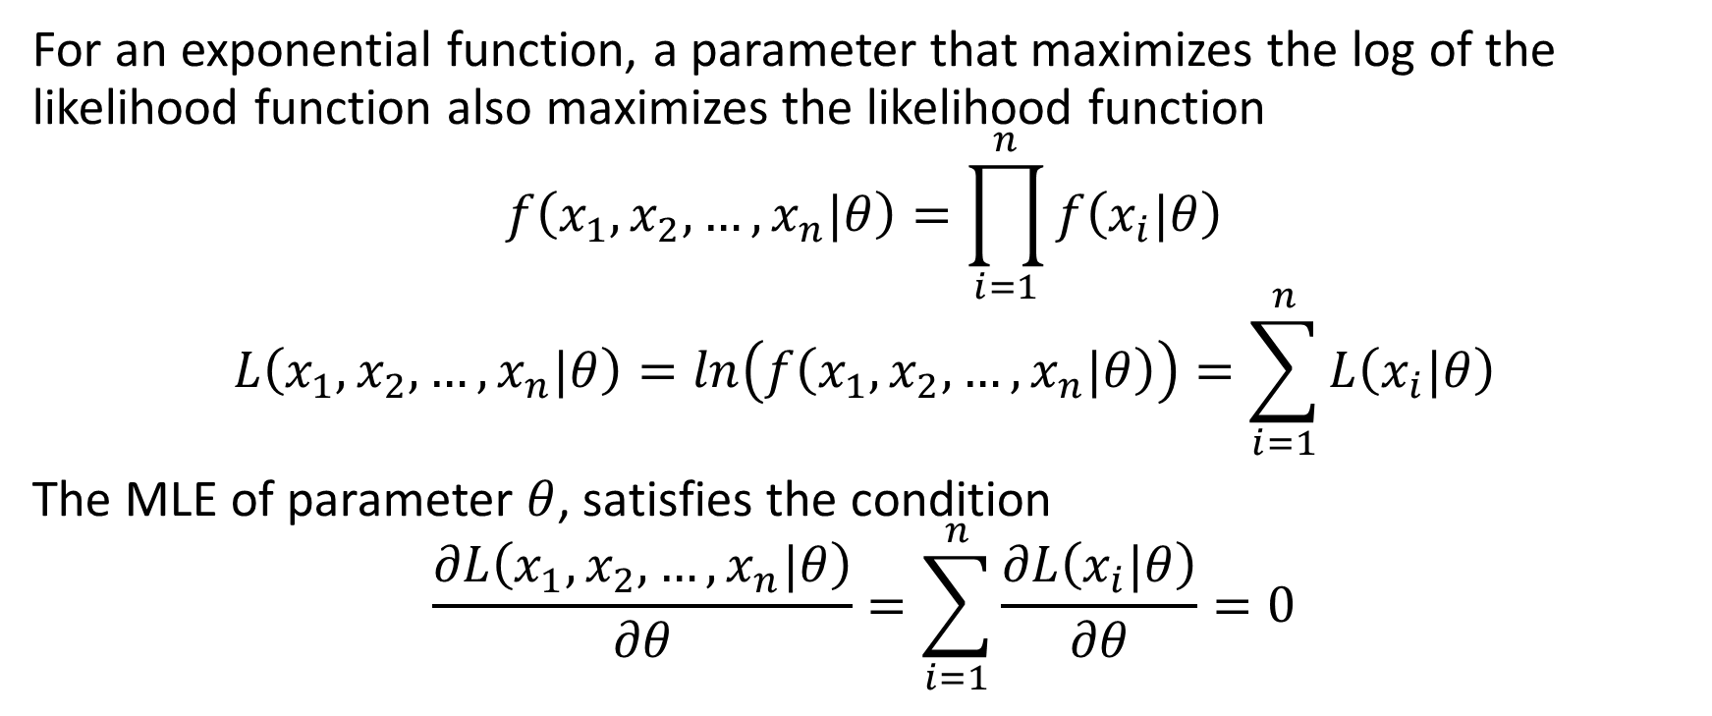
Maximum Likelihood Estimators
For an exponential function, a parameter that maximizes the log of the likelihood function also maximizes the likelihood function
$$f\left(x_{1}, x_{2}, …, x_{n}|θ\right)=\prod_{i=1}^{n}{f\left(x_{i}|θ\right)}$$
$$L\left(x_{1}, x_{2}, …, x_{n}|θ\right)=ln\left(f\left(x_{1}, x_{2}, …, x_{n}|θ\right)\right)=\sum_{i=1}^{n}{L\left(x_{i}|θ\right)}$$
The MLE of parameter $θ$, satisfies the condition
$$\frac{∂L\left(x_{1}, x_{2}, …, x_{n}|θ\right)}{∂θ}=\sum_{i=1}^{n}{\frac{∂L\left(x_{i}|θ\right)}{∂θ}}=0$$

Slide 25
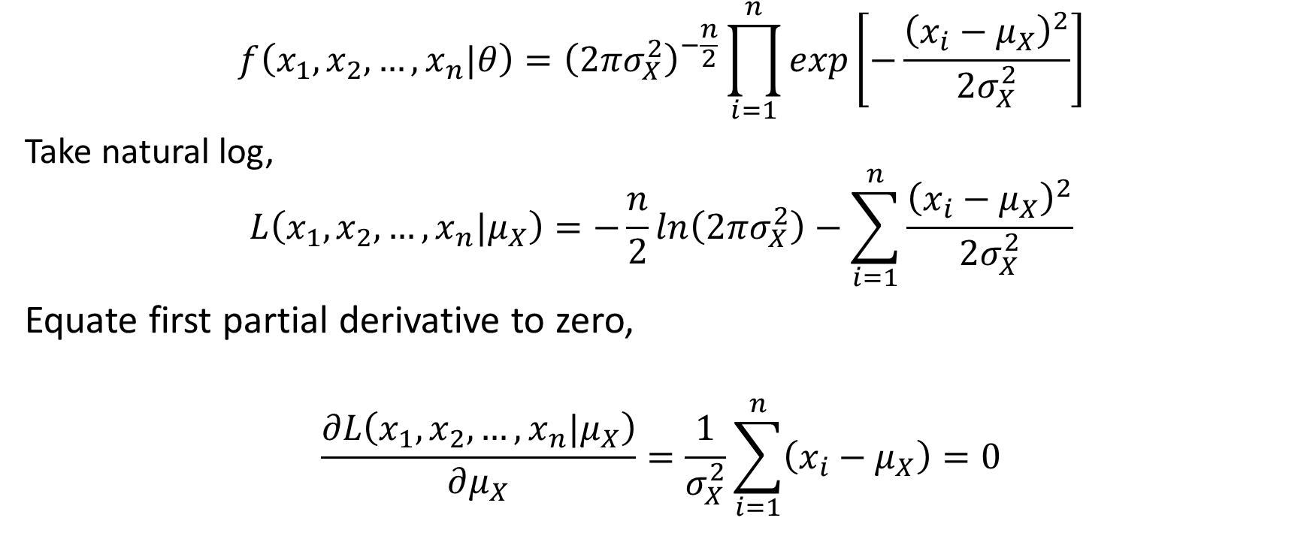

MLE of the Mean - Known Variance ($θ=μ_{X}$)
$$f\left(x_{1}, x_{2}, …, x_{n}|θ\right)={\left(2πσ_{X}^{2}\right)}^{−\frac{n}{2}}\prod_{i=1}^{n}{exp\left[−\frac{{\left(x_{i}−μ_{X}\right)}^{2}}{2σ_{X}^{2}}\right]}$$
Take natural log,
$$L\left(x_{1}, x_{2}, …, x_{n}|μ_{X}\right)=−\frac{n}{2}ln\left(2πσ_{X}^{2}\right)−\sum_{i=1}^{n}{\frac{{\left(x_{i}−μ_{X}\right)}^{2}}{2σ_{X}^{2}}}$$
Equate first partial derivative to zero,
$$\frac{∂L\left(x_{1}, x_{2}, …, x_{n}|μ_{X}\right)}{∂μ_{X}}=\frac{1}{σ_{X}^{2}}\sum_{i=1}^{n}{\left(x_{i}−μ_{X}\right)}=0$$

Slide 26
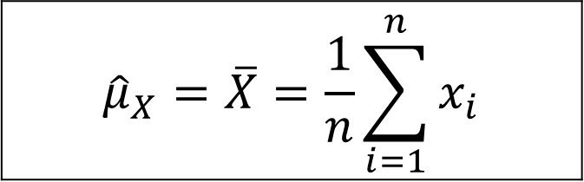
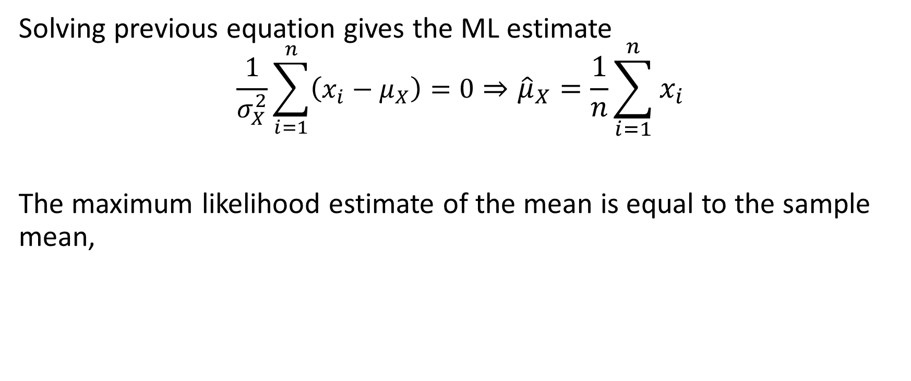
MLE of the Mean - Known Variance
Solving previous equation gives the ML estimate
$$\frac{1}{σ_{X}^{2}}\sum_{i=1}^{n}{\left(x_{i}−μ_{X}\right)}=0⇒{\hat{μ}}_{X}=\frac{1}{n}\sum_{i=1}^{n}{x_{i}}$$
The maximum likelihood estimate of the mean is equal to the sample mean,
$${\hat{μ}}_{X}=\overline{X}=\frac{1}{n}\sum_{i=1}^{n}{x_{i}}$$

Slide 27
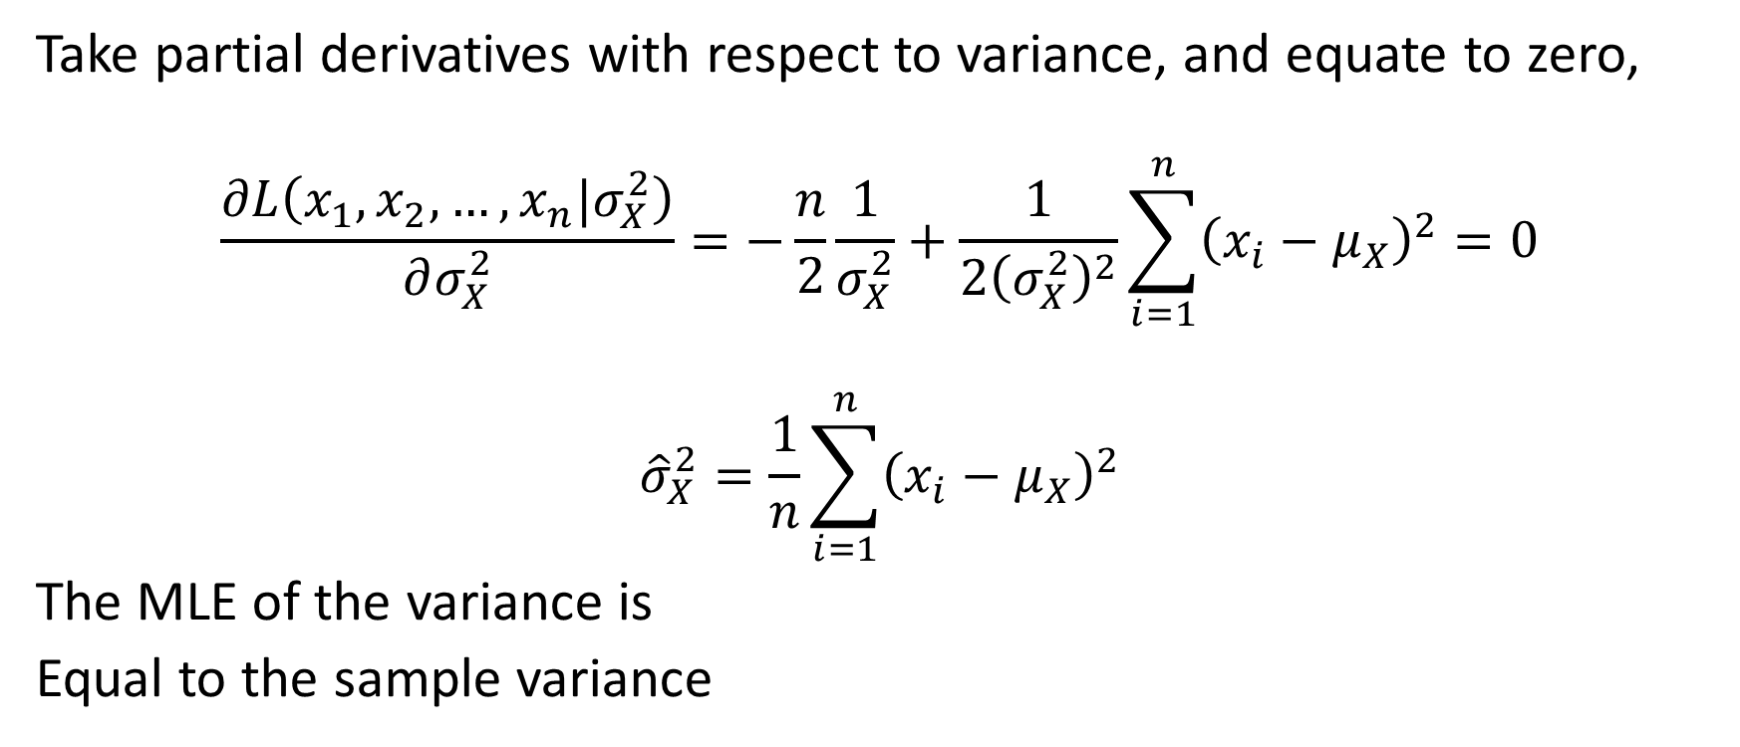

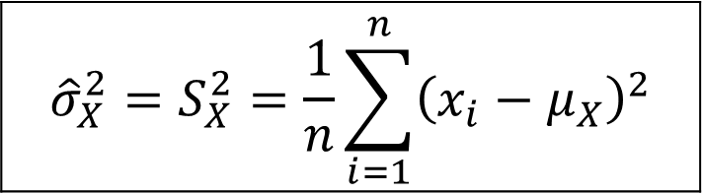
MLE of the Variance $σ_{X}^{2}$ $with$ Known Mean $μ_{X}$
Take partial derivatives with respect to variance, and equate to zero,
$$\frac{∂L\left(x_{1}, x_{2}, …, x_{n}|σ_{X}^{2}\right)}{∂σ_{X}^{2}}=−\frac{n}{2}\frac{1}{σ_{X}^{2}}+\frac{1}{{2\left(σ_{X}^{2}\right)}^{2}}\sum_{i=1}^{n}{{\left(x_{i}−μ_{X}\right)}^{2}=0}$$
$${\hat{σ}}_{X}^{2}=\frac{1}{n}\sum_{i=1}^{n}{{\left(x_{i}−μ_{X}\right)}^{2}}$$
The MLE of the variance is
Equal to the sample variance
$${\hat{σ}}_{X}^{2}=S_{X}^{2}=\frac{1}{n}\sum_{i=1}^{n}{{\left(x_{i}−μ_{X}\right)}^{2}}$$

Slide 28
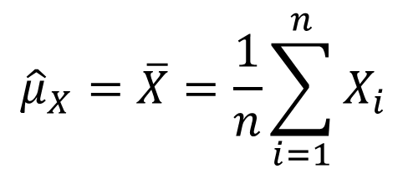

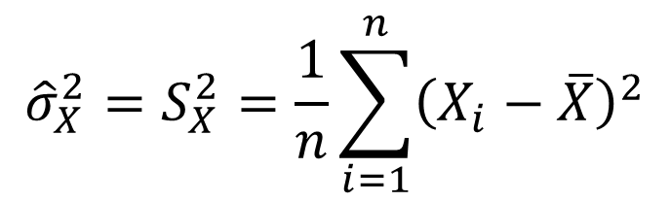
Estimation of Unknown Mean and Variance
Two parameters to estimate: $θ_{1}=μ_{X} and θ_{2}=σ_{X}^{2},$
Note: The MLE of the mean is an unbiased estimate while the MLE of the variance is biased.
$${\hat{μ}}_{X}=\overline{X}=\frac{1}{n}\sum_{i=1}^{n}{X_{i}}$$
$${\hat{σ}}_{X}^{2}=S_{X}^{2}=\frac{1}{n}\sum_{i=1}^{n}{{\left(X_{i}−\overline{X}\right)}^{2}}$$

Slide 29
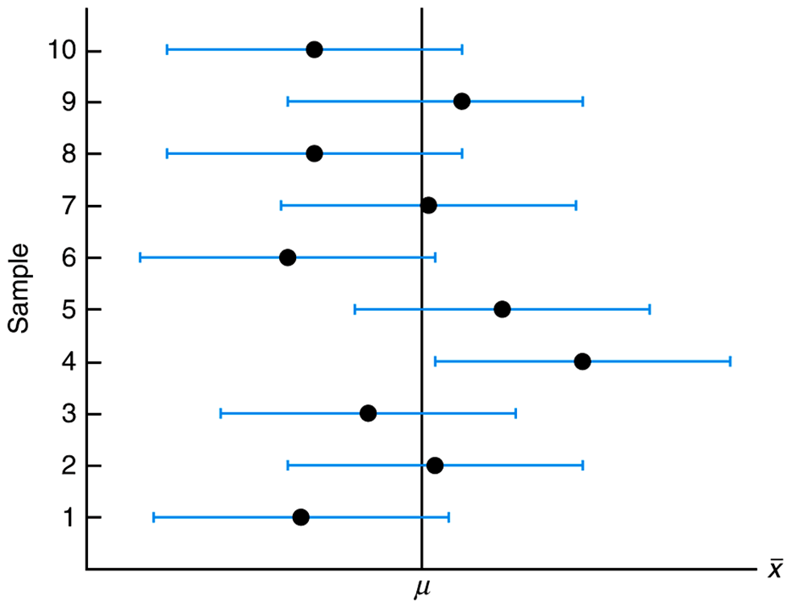
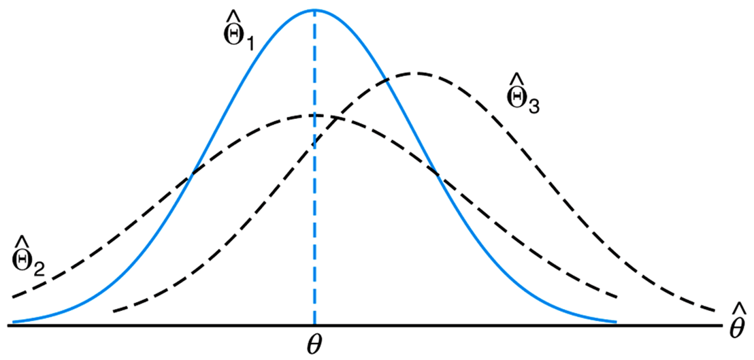
Interval Estimation and Confidence Interval
Copyright © 2010 Pearson Addison-Wesley. All rights reserved.

Slide 30
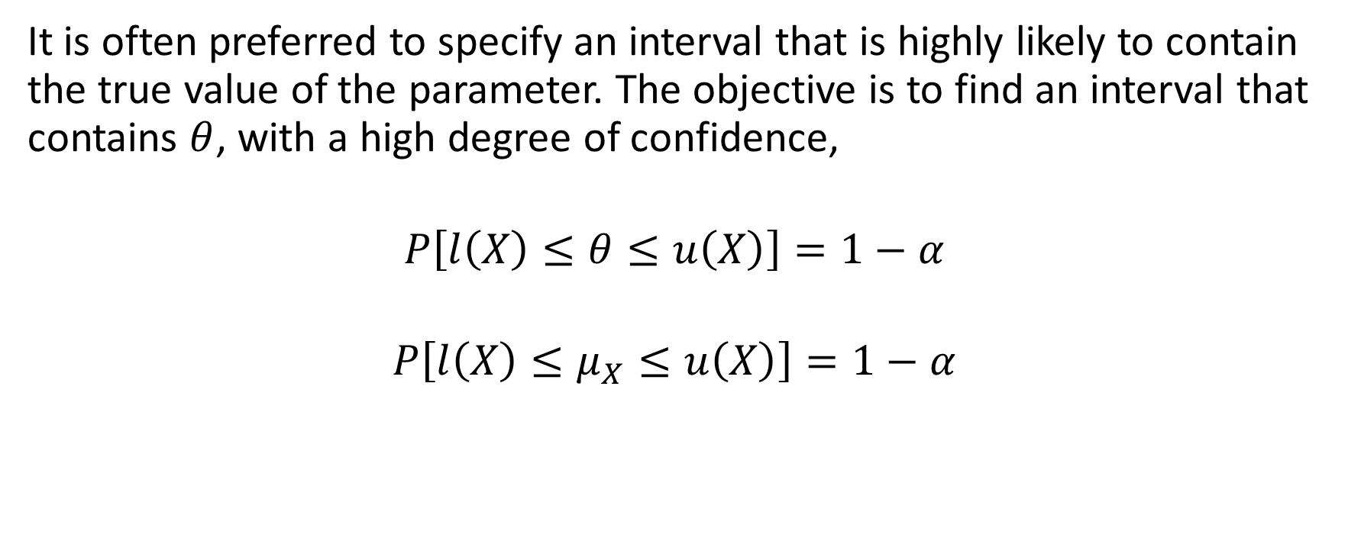
Interval Estimation and Confidence Interval
It is often preferred to specify an interval that is highly likely to contain the true value of the parameter. The objective is to find an interval that contains $θ$, with a high degree of confidence,
$$P\left[l\left(X\right)≤θ≤u\left(X\right)\right]=1−α$$
$$P\left[l\left(X\right)≤μ_{X}≤u\left(X\right)\right]=1−α$$

Slide 31
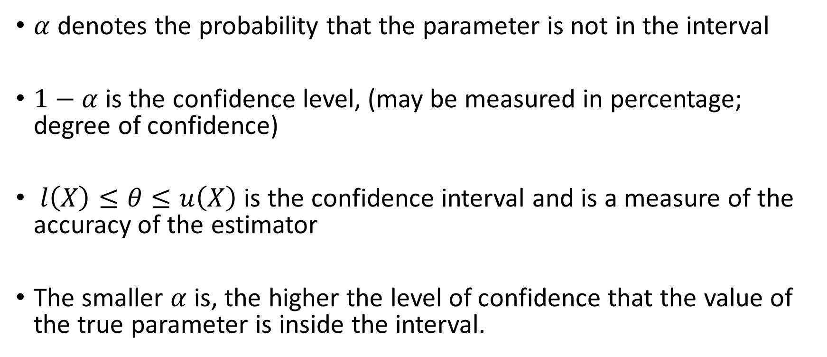
Interval Estimation and Confidence Interval
$α$ denotes the probability that the parameter is not in the interval
$1−α$is the confidence level, (may be measured in percentage; degree of confidence)
$l\left(X\right)≤θ≤u\left(X\right)$is the confidence interval and is a measure of the accuracy of the estimator
The smaller $α$ is, the higher the level of confidence that the value of the true parameter is inside the interval.

Slide 32
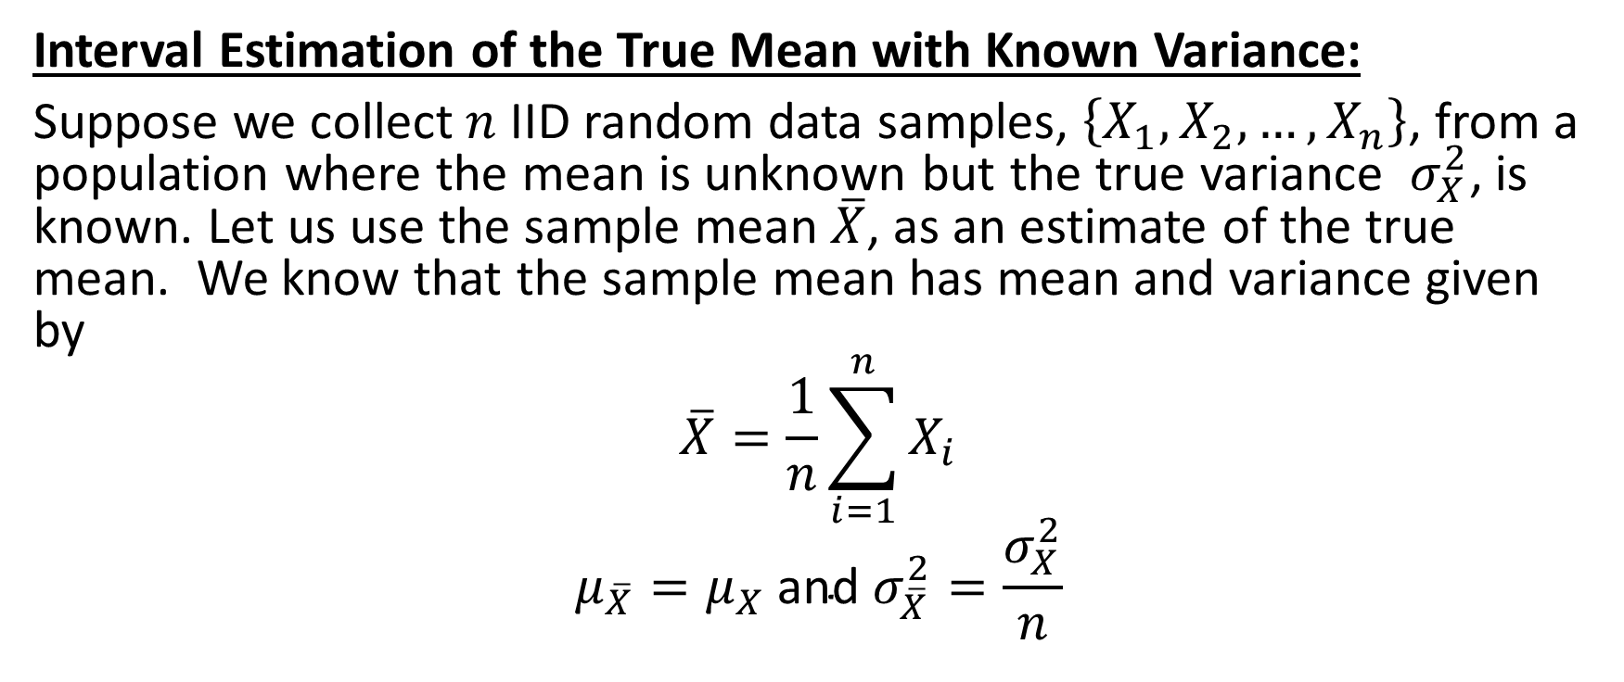
Interval Estimation Procedure of the Mean
Interval Estimation of the True Mean with Known Variance:
Suppose we collect $n$ IID random data samples, $\left\{X_{1}, X_{2}, …, X_{n}\right\}$, from a population where the mean is unknown but the true variance $σ_{X}^{2}$, is known. Let us use the sample mean $\overline{X}$, as an estimate of the true mean. We know that the sample mean has mean and variance given by
$$\overline{X}=\frac{1}{n}\sum_{i=1}^{n}{X_{i}}$$
$$μ_{\overline{X}}=μ_{X} \text{and} σ_{\overline{X}}^{2}=\frac{σ_{X}^{2}}{n}$$

Slide 33
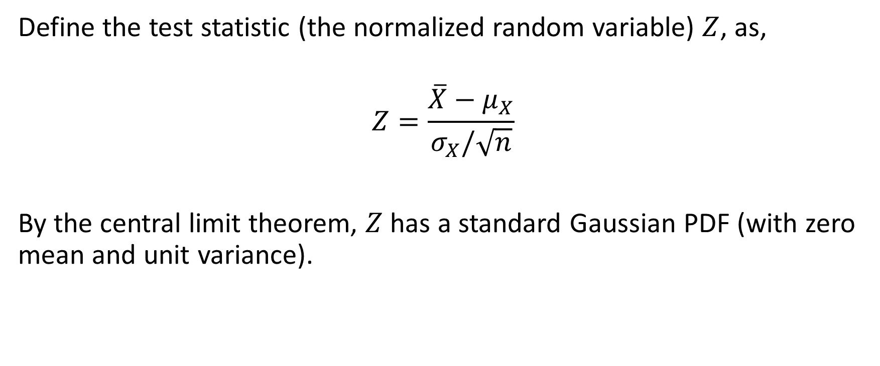
Interval Estimation Procedure of the Mean
Define the test statistic (the normalized random variable) $Z$, as,
$$Z=\frac{\overline{X}−μ_{X}}{σ_{X}/\sqrt{n}}$$
By the central limit theorem, $Z$ has a standard Gaussian PDF (with zero mean and unit variance).

Slide 34
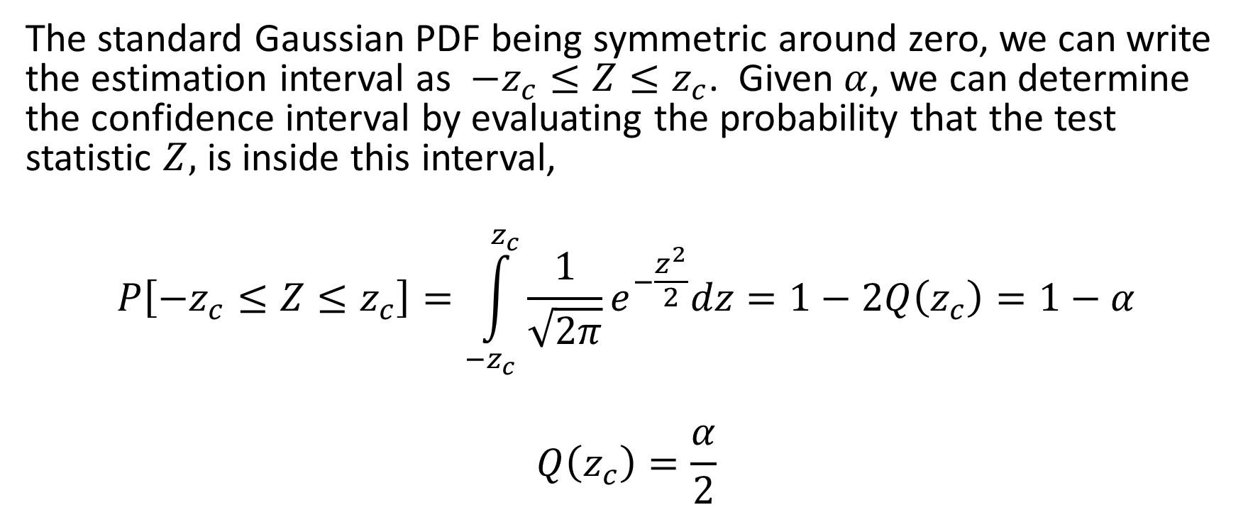
Interval Estimation Procedure of the Mean
The standard Gaussian PDF being symmetric around zero, we can write the estimation interval as $−z_{c}≤Z≤z_{c}$. Given $α$, we can determine the confidence interval by evaluating the probability that the test statistic $Z,$ is inside this interval,
$$P\left[−z_{c}≤Z≤z_{c}\right]=\int_{−z_{c}}^{z_{c}}{\frac{1}{\sqrt{2π}}}e^{−\frac{z^{2}}{2}}dz=1−2Q\left(z_{c}\right)=1−α$$
$$Q\left(z_{c}\right)=\frac{α}{2}$$

Slide 35
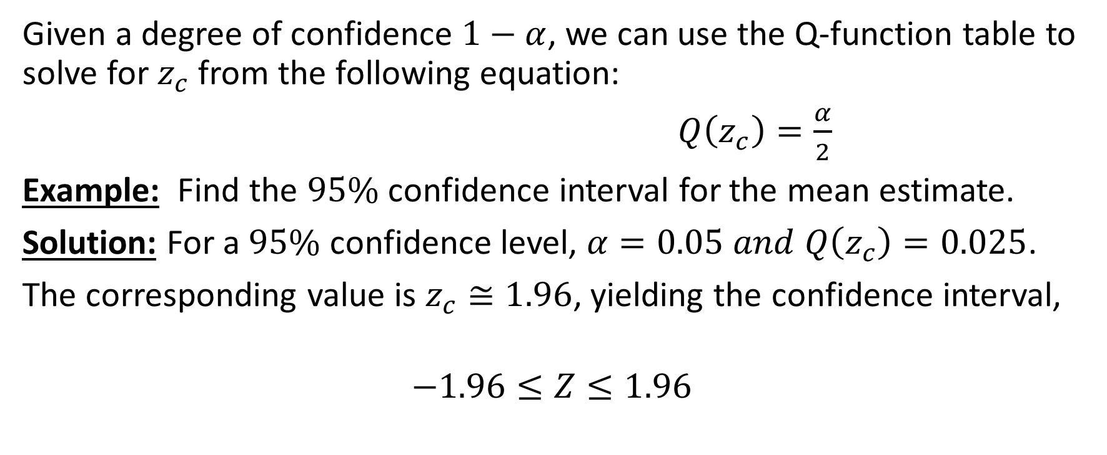
Interval Estimation Procedure of the Mean
Given a degree of confidence $1−α$, we can use the Q-function table to solve for $z_{c}$ from the following equation:
$Q\left(z_{c}\right)=\frac{α}{2}$
Example: Find the $95\%$ confidence interval for the mean estimate.
Solution: For a $95\%$ confidence level, $α=0.05 and Q\left(z_{c}\right)=0.025$.
The corresponding value is $z_{c}≅1.96$, yielding the confidence interval,
$$−1.96≤Z≤1.96$$

Slide 36
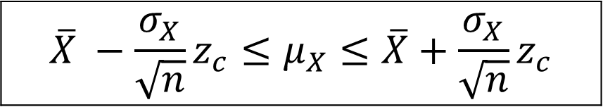
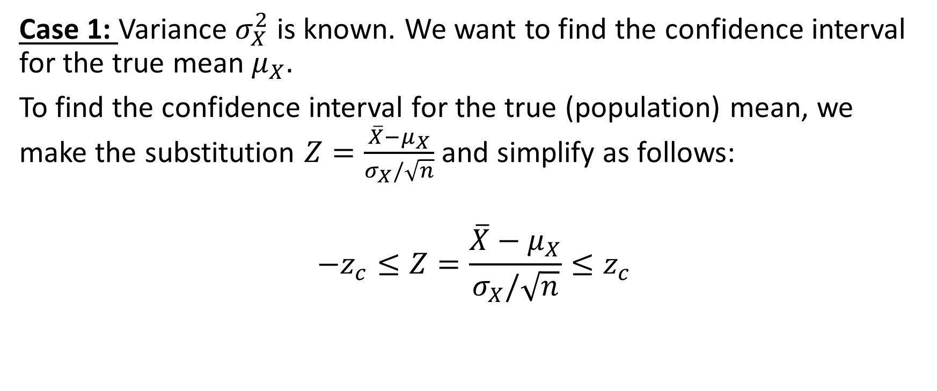
Confidence Interval for True Mean
Case 1: Variance $σ_{X}^{2}$ is known. We want to find the confidence interval for the true mean $μ_{X}.$
To find the confidence interval for the true (population) mean, we make the substitution $Z=\frac{\overline{X}−μ_{X}}{σ_{X}/\sqrt{n}}$ and simplify as follows:
$$−z_{c}≤Z=\frac{\overline{X}−μ_{X}}{σ_{X}/\sqrt{n}}≤z_{c}$$
$$\overline{X} −{\frac{σ_{X}}{\sqrt{n}}z}_{c}≤μ_{X}≤\overline{X}+{\frac{σ_{X}}{\sqrt{n}}z}_{c}$$

Slide 37
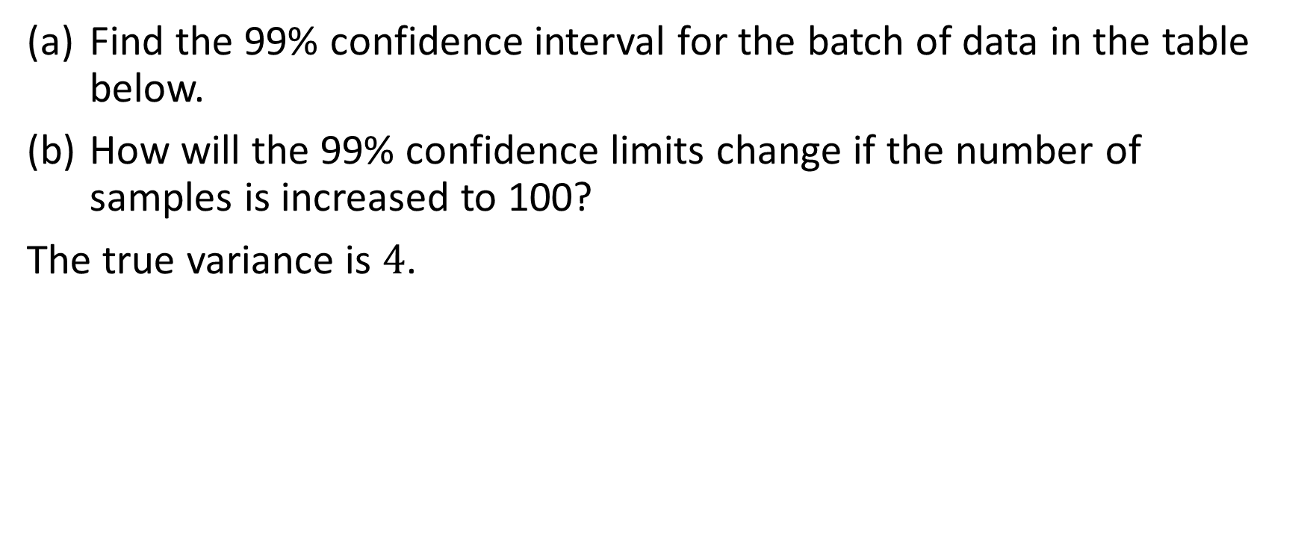
Interval Estimation - Example 1
Find the 99% confidence interval for the batch of data in the table below.
How will the 99% confidence limits change if the number of samples is increased to 100?
The true variance is $4$.

Slide 38
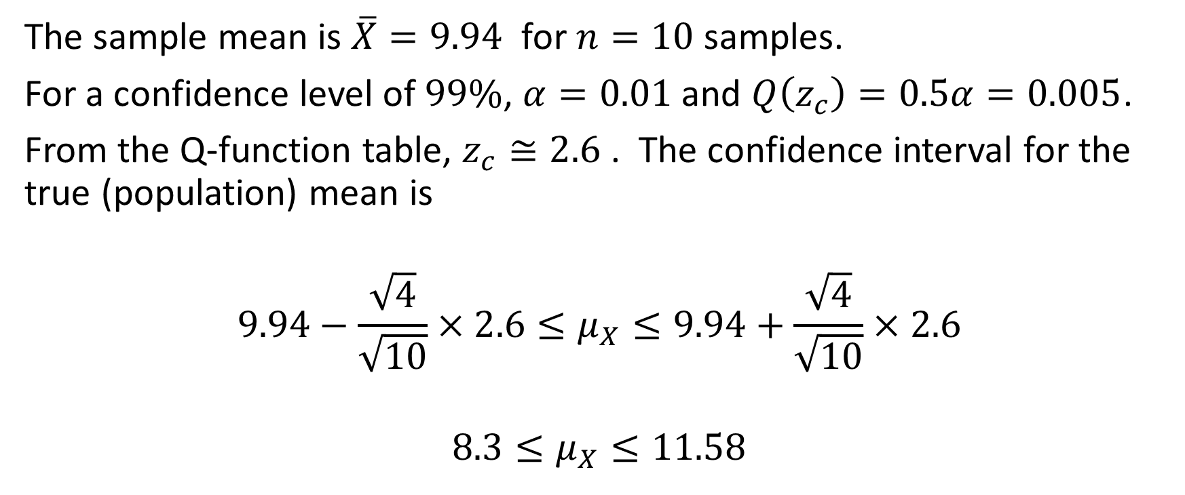
Interval Estimation - Example 1 Solution
The sample mean is $\overline{X}=9.94$ for $n=10$ samples.
For a confidence level of $99\%$, $α=0.01$ and $Q\left(z_{c}\right)=0.5α=0.005$.
From the Q-function table, $z_{c}≅2.6$ . The confidence interval for the true (population) mean is
$$9.94−\frac{\sqrt{4}}{\sqrt{10}}×2.6≤μ_{X}≤9.94+\frac{\sqrt{4}}{\sqrt{10}}×2.6$$
$$8.3≤μ_{X}≤11.58$$

Slide 39
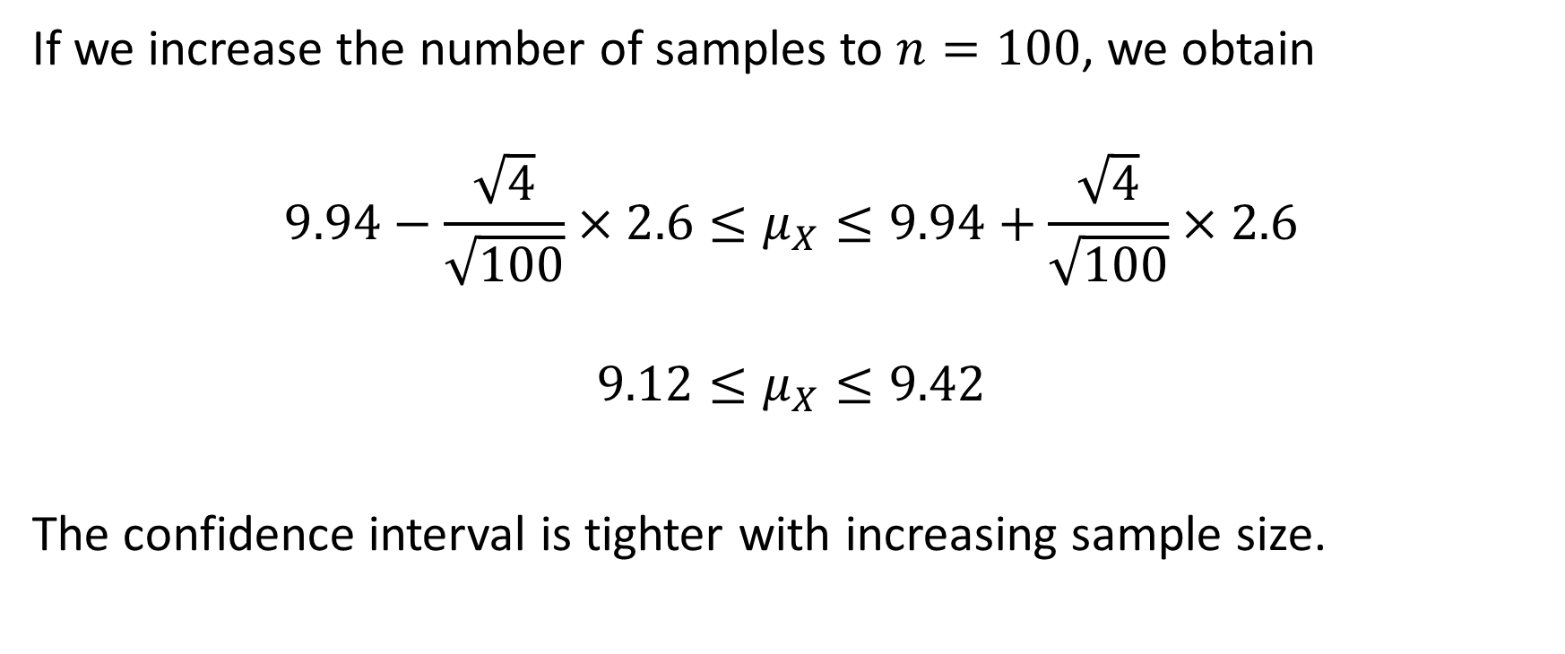
Interval Estimation - Example 1 Solution
If we increase the number of samples to $n=100$, we obtain
$$9.94−\frac{\sqrt{4}}{\sqrt{100}}×2.6≤μ_{X}≤9.94+\frac{\sqrt{4}}{\sqrt{100}}×2.6$$
$$9.12≤μ_{X}≤9.42$$
The confidence interval is tighter with increasing sample size.

Slide 40
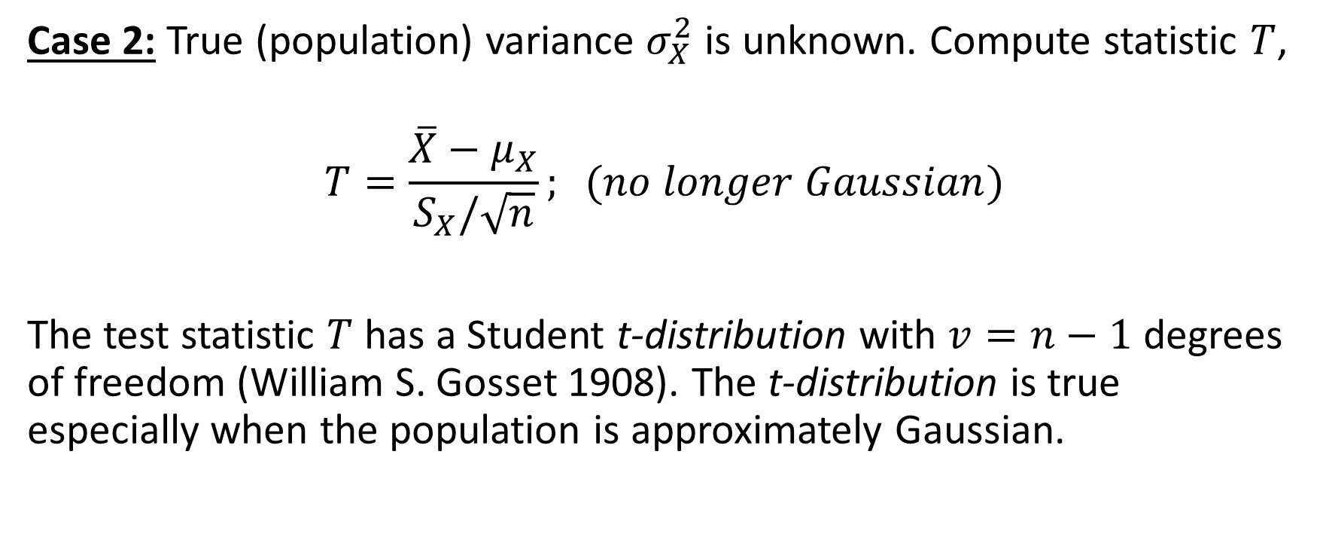
Confidence Interval for True Mean
Case 2: True (population) variance $σ_{X}^{2}$ is unknown. Compute statistic $T$,
$$T=\frac{\overline{X}−μ_{X}}{S_{X}/\sqrt{n}}; (no longer Gaussian)$$
The test statistic $T$ has a Student t-distribution with $v=n−1$ degrees of freedom (William S. Gosset 1908). The t-distribution is true especially when the population is approximately Gaussian.

Slide 41
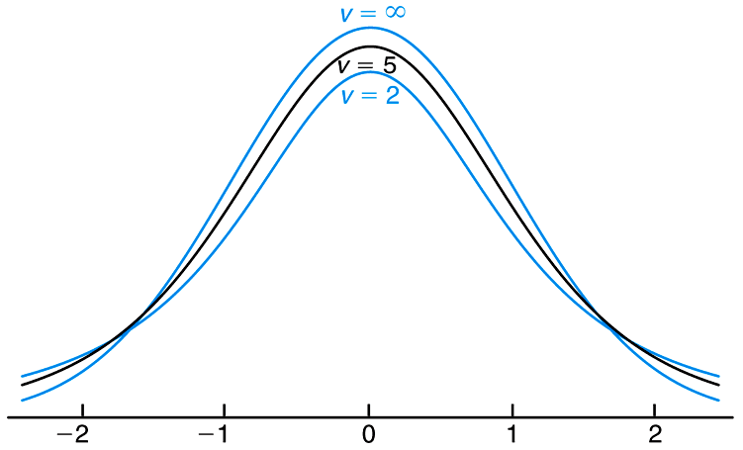

The t-distribution curves for v = 2, 5, and $∞$
Like the standard Gaussian,
the Student distribution is
Symmetric around zero.
Copyright © 2010 Pearson Addison-Wesley. All rights reserved.

Slide 42
T-Distribution Table, ENEL 419 Textbook
Montgomery & Runger “Applied Statistics
And Probability for Engineers,” 7th edition,
Wiley

Slide 43
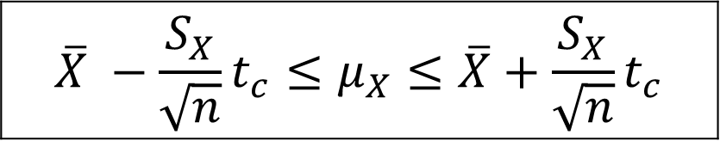
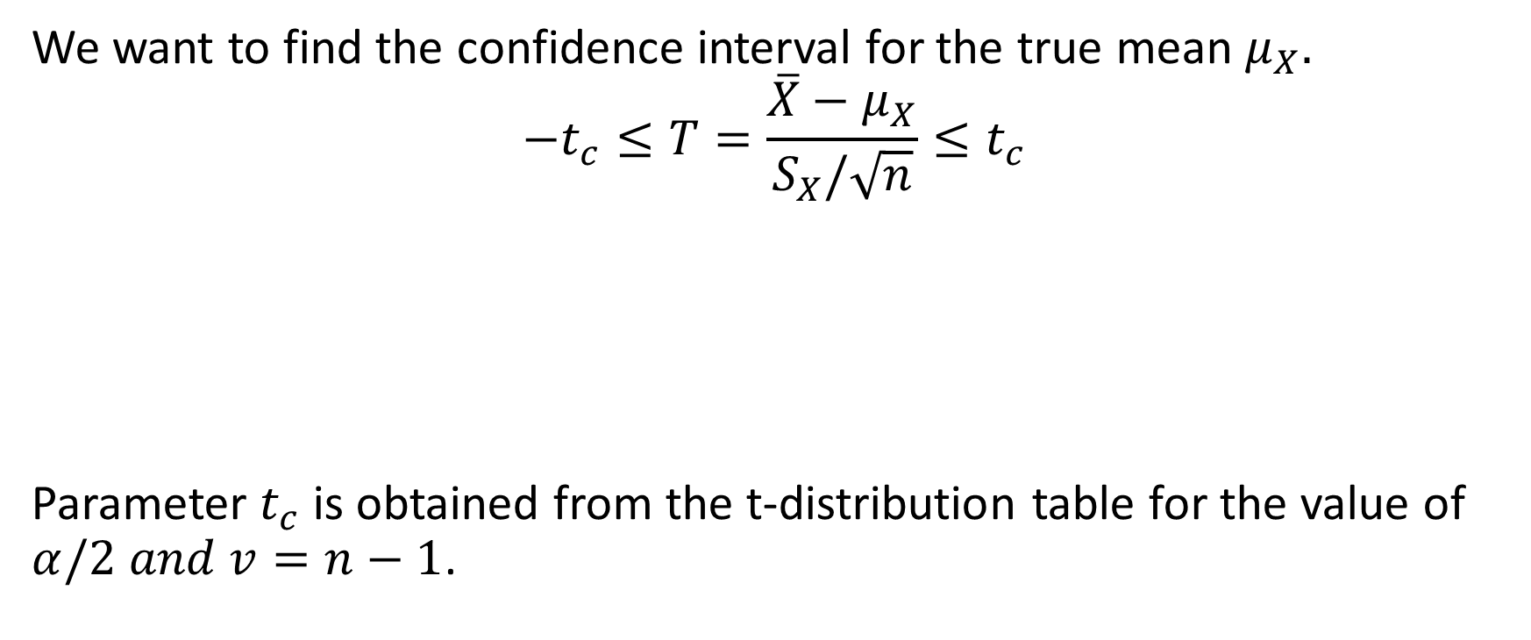
Confidence Interval for True Mean
We want to find the confidence interval for the true mean $μ_{X}.$
$$−t_{c}≤T=\frac{\overline{X}−μ_{X}}{S_{X}/\sqrt{n}}≤t_{c}$$
Parameter $t_{c}$ is obtained from the t-distribution table for the value of $α/2 and v=n−1$.
$$\overline{X} −{\frac{S_{X}}{\sqrt{n}}t}_{c}≤μ_{X}≤\overline{X}+{\frac{S_{X}}{\sqrt{n}}t}_{c}$$

Slide 44
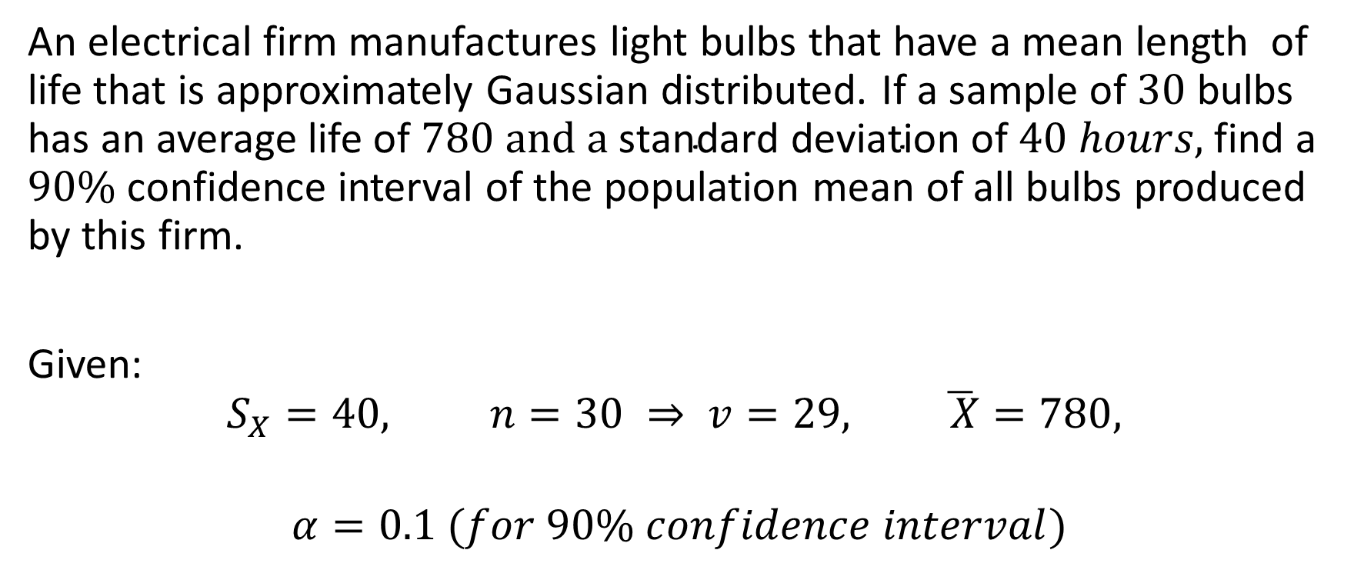
Interval Estimation - Example 2
An electrical firm manufactures light bulbs that have a mean length of life that is approximately Gaussian distributed. If a sample of $30$ bulbs has an average life of $780 and a \text{standard} \text{deviation} \text{of} 40 hours\text{, }$find a $90\%$ confidence interval of the population mean of all bulbs produced by this firm.
Given:
$$S_{X}=40, n=30 ⇒ v=29, \overline{ X}=780,$$
$$α=0.1 (for 90\% confidence interval)$$

Slide 45
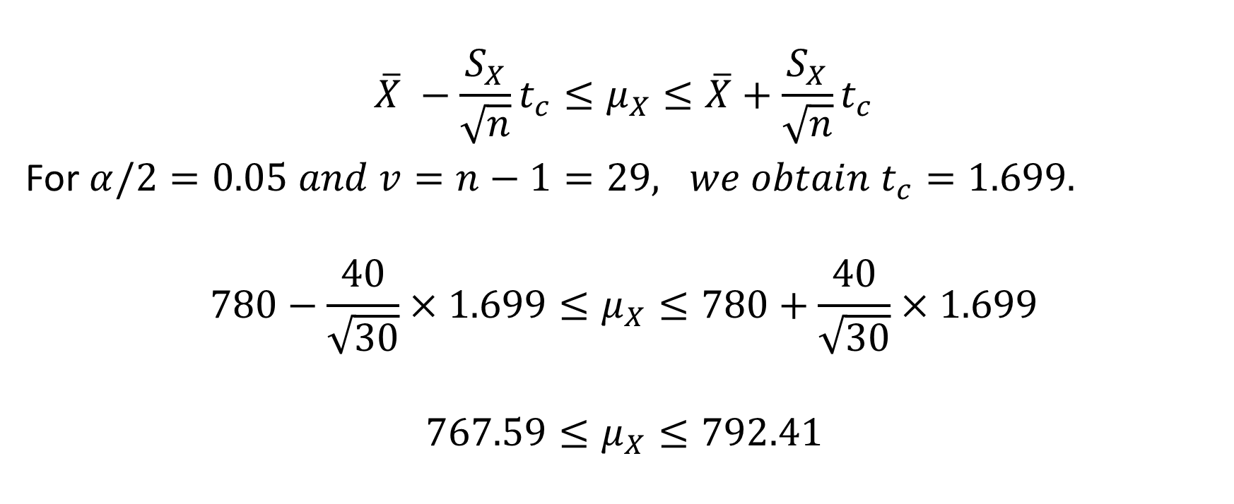
Interval Estimation - Example 2 Solution
$$\overline{X} −{\frac{S_{X}}{\sqrt{n}}t}_{c}≤μ_{X}≤\overline{X}+{\frac{S_{X}}{\sqrt{n}}t}_{c}$$
For $α/2=0.05 and v=n−1=29, we obtain t_{c}=1.699.$
$$780−\frac{40}{\sqrt{30}}×1.699≤μ_{X}≤780+\frac{40}{\sqrt{30}}×1.699$$
$$767.59≤μ_{X}≤792.41$$

